Slide 1
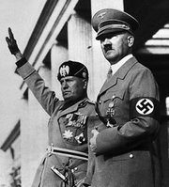
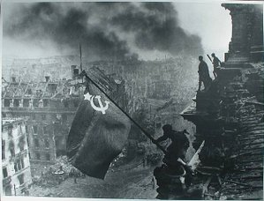
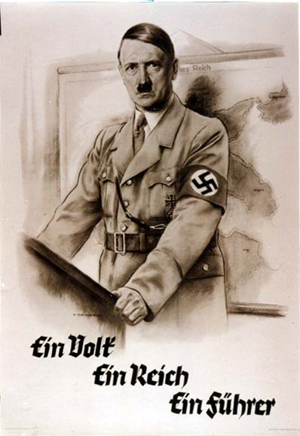
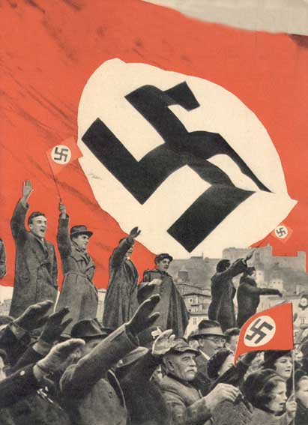
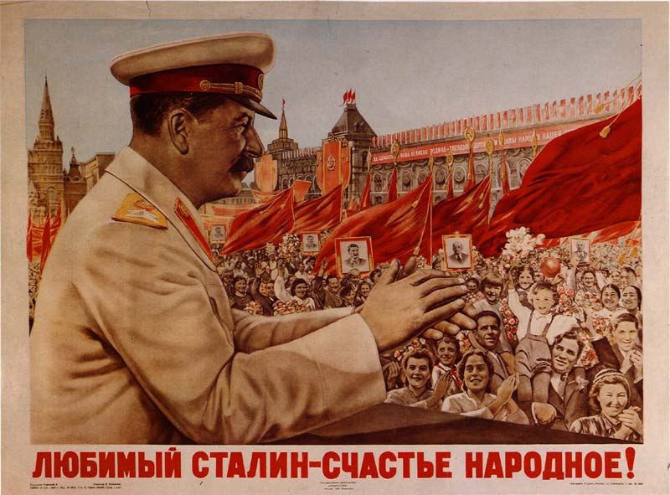
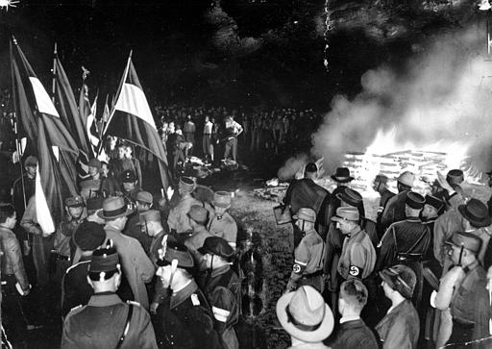
The Rise of Totalitarian Leaders
By Polina Davydov
Period 5 EHAP
Mr. Kinberg

Slide 2
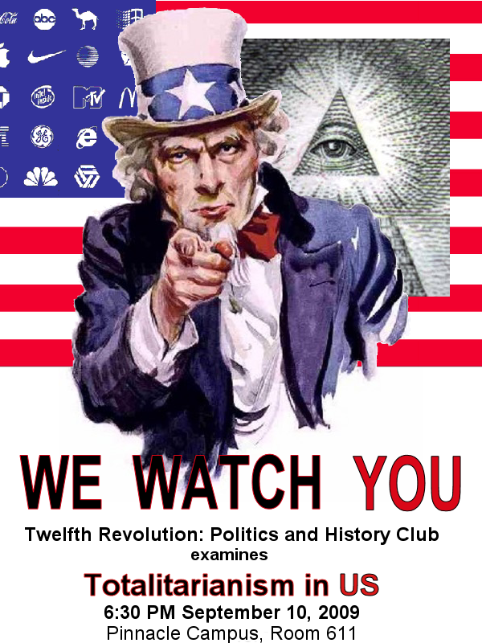
What is Totalitarianism?
Characteristics of Totalitarianism:
Government establishes complete control of all aspects of the state
(political, military, economy, social, cultural)
Highly nationalistic (flags, salutes, rallies, uniforms)
Strict controls and laws
Military state (secret police, army, military)
Censorship (opposing literature and ideas)
Propaganda (media – radio, newspapers, posters)
One leader (dictator); charismatic
Total conformity of people to ideas and leader
Terror and Fear

Slide 3
Totalitarianism vs. Older Concepts of Dictatorship
-Seek to dominate all -Seek limited, typically political
aspects of national life control
-Mobilize and make use -Seek pacified and submissive
of mass political populations
participation
-Seek the complete -Attempt to rule over the
reconstruction of the individual and society
individual and society

Slide 4
Important Terms
Totalitarianism—government that dominates every aspect of life
Totalitarian leader often dynamic, persuasive
Police Terror
Government uses police to spy on, intimidate people, use brutal force or even murder people
Indoctrination
Government shapes people’s minds through slanted education (use schools)
Propaganda and Censorship
Government controls all mass media (newspapers, radio)
crushes opposing views; censor info. from becoming public; used arts to promote views
Religious or Ethnic Persecution
Leaders brand religious, ethnic minorities “enemies of the state” (Communists = atheists)
Churches were destroyed; church leaders were sent into exile or killed

Slide 5
Causes of Totalitarianism
Treaty of Versailles
Black Tuesday
1929
- stock market crashes
Great Depression
during
1930s
Totalitarianism
Increasing influence of new
political parties that emphasize
state control
-For example: Communism,
Nazism, Fascism
Total Control
of State by a
Dictator

Slide 6
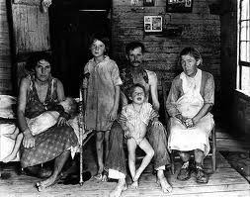
Atmosphere in Europe Post- WWI
A. European Struggle
1. Economic issues
a. Depression- worldwide, especially Europe and U.S.
b. Hyperinflation- Germany, 1920s
c. Loss of manpower and industry due to WWI
d. Food issues (starvation in Germany)
2. Nationalism
a. Extreme love for one’s country
1. Embarrassment for the Germans after the War Guilt clause and reparations.
2. Military restrictions for Germany
a. Max 100,000 troops and air force/navy limits
3. Nationalist feelings in England, France and Italy as well
3. Angry Population
a. Bitterness
b. Looking for a solution, or an answer
c. A return to greatness?
*These new leaders promised economic recovery, military might, and above all, a restoration of pride and hope!

Slide 7
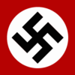
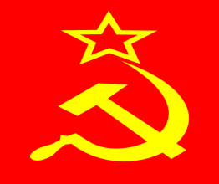
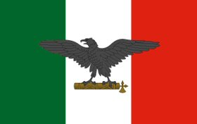
The Three Most Prominent Forms
Totalitarianism

Slide 8
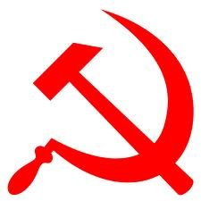
What is Communism?
LEFT WING
Based on theory by Karl Marx
Revolutionary idea of a political, economic and social system that creates a “classless society”
State ownership and control of the means of production (no private ownership)
Soviet Communism or “Stalinism”, was more of a totalitarian and military state combined with elements of communism

Slide 9
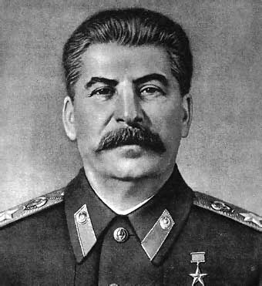
Joseph Stalin- Leader of the Soviet Union from 1922-1953
Country: Soviet Union
Type of Government: Communism (dictatorship)
Goals and Ideas:
  Crushed opponents and took control after Lenin’s death
  Held absolute authority; suppressed resistance
  Brought his country to world power status but imposed upon it one of the most ruthless regimes in history
  New Economic Policies (NEP)
    Collectivization: exported seized goods and gained enough capital to finance a massive industrialization drive
    Rapid industrialization: three 5-year plans
  The Great Purges: KGB = secret police killed thousands of army officers and prominent Bolsheviks who opposed Stalin
  Feared the growing power of Nazi Germany

Slide 10
Stalin on the Worker’s Paradise
"If there had been a crisis in our country, if there had been unemployment - the scourge of the working class, if there had been abject poverty, if output hadn't gone up, if our workers and peasants didn't have such a good government who looked after them, who cared about them - in a word, if you lived badly, joylessly - we would not have heroes and heroines of socialism, I can assure you.“- Joseph Stalin

Slide 11
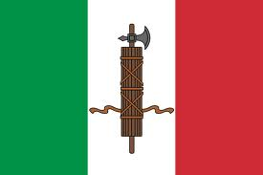
What is Fascism?
RIGHT WING
Intense nationalism and elitism
Totalitarian control
Interests of the state more important than individual rights
Maintain class system and private ownership
Fun Fact: Fascism name was derived from the fasces, an ancient Roman symbol of authority consisting of a bundle of rods and an ax

Slide 12
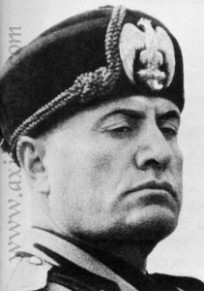
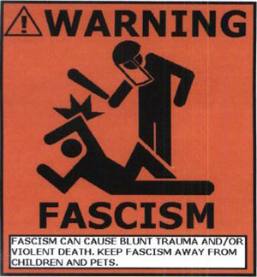
Benito Mussolini- Leader (Il Duce) of Italy from 1922-1943
Country: Italy
Type of Government: Fascism (dictatorship)
Goals and Ideas:
  Centralized all power in himself as leader (total control of social, economic, and political life)
  Ambition to restore the glory of Rome
  Invasion of Ethiopia
  Alliance with Hitler’s Germany

Slide 13
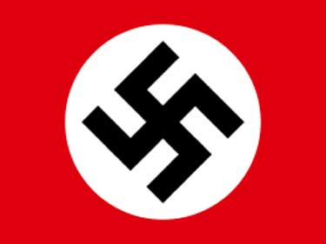
What is Nazism
RIGHT WING
Extremely fascist , nationalistic and totalitarian
Based on beliefs of the National Socialist German Workers Party
Belief in the racial superiority of the Aryan, the “master race”
Belief that all Germans should have “lebensraum” or living space in Europe
Violent hatred towards Jews and blamed Germany’s problems on them

Slide 14
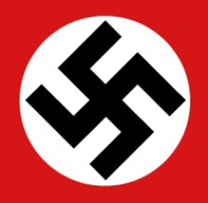
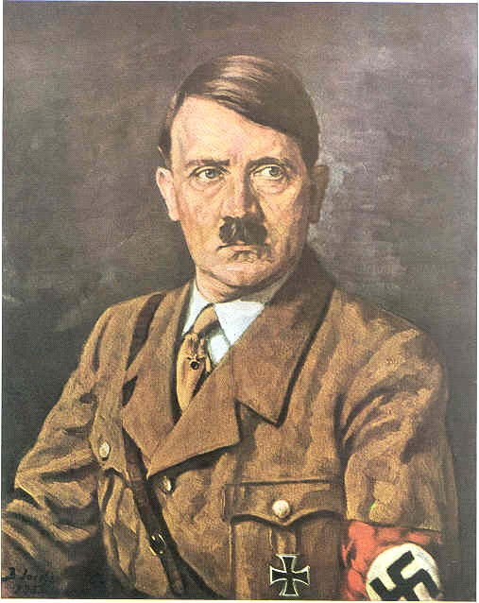
Adolf Hitler- Leader (der Fuhrer) of Germany from 1933 -1945
Country: Germany
Type of Government: Nazism (dictatorship)
Goals and Ideas:
  Inflation and depression weakened the democratic government in Germany and allowed an opportunity for Hitler to rise to power
  Believed the western powers had no intention of using force to maintain the Treaty of Versailles
  Anti-Semitism: persecution of Jews
  Extreme nationalism: National Socialism (aka Nazism)
  Aggression: German occupation of nearby countries
  Lebensraum: unite all German speaking nations
  Anschluss: German union with Austria

Slide 15
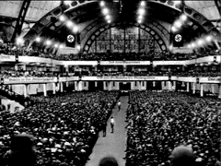
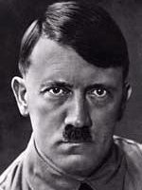
You Must Obey
The evening that Hitler became Chancellor of Germany, he spoke to his S.A. and S.S. troops: "SA and SS, Heil! The great time has now begun. Germany is now awakened. We have won power in Germany. Now we must win over the German people. I know, my comrades, it must have been difficult at times, when you were desiring change which didn't come, so time and time again the appeal has to be made to continue the struggle - you mustn't act yourself, you must obey, you must give in, you must submit to this overwhelming need to obey."
Link to Speech: http://www.youtube.com/watch?v=eGhdX1SI3KY&bpctr=1362500216

Slide 16
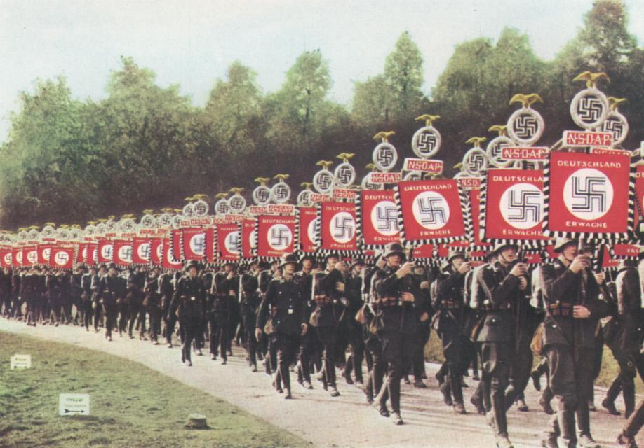
How Nazi Controls Affected the People
GESTAPO: the Secret State Police
SS (Schutzstaffel): Defense Corps “black shirts”, an elite guard unit formed out of the SA
SA (Sturmabteilung): Stormtroopers "brown-shirts" early private Nazi army that protected leaders and opposed rival political parties
Lebensraum (living space): concept that emphasized need for territorial expansion of Germany into east
Wehrmacht: German army
HJ (Hitler Jugend): Hitler Youth
Einstazgruppen: Nazi Death Squad; mobile killing units
Volk: all inclusive concept of nation, people and race, implying the superiority of German culture and race; led to policy of Volksgemeinschaft (idea of a harmonized racial Nazi community in government policies and programs)
DEATH TOLL: Over 50 Million (following WWII)

Slide 17
Works Cited
Borejsza, Jerzy W., Klaus Ziemer, and Magdalena Hułas. Totalitarian and Authoritarian Regimes in Europe: Legacies and Lessons from the Twentieth Century. New York: Berghahn, 2006. Print.
Chambers, Mortimer. The Western Experience. New York: Knopf; [distributed by Random House, 1974. Print.
Cohrs, Patrick O. The Unfinished Peace after World War I: America, Britain and the Stabilisation of Europe, 1919-1932. Cambridge, UK: Cambridge UP, 2006. Print.
"Google Images." Google Images. N.p., n.d. Web. 01 Mar. 2013.
Sherman, Dennis, and Joyce E. Salisbury. West: Experience Western Civilization. New York: McGraw-Hill, 2012. Print.
"Totalitarianism (government)." Encyclopedia Britannica Online. Encyclopedia Britannica, n.d. Web. 27 Feb. 2013.
"Totalitarianism." Wikipedia. Wikimedia Foundation, 03 Mar. 2013. Web. 13 Feb. 2013.

